Slide 1
Outcome-Based Education (OBE)
OBE is an approach that focuses on the attainment of course outcomes (COs)

Slide 2
Requirement from Qualification Bodies
Undergraduate curriculum needs to be transformed into adopting OBE in accordance with requirements from:
Malaysian Qualifications Framework (MQF) of Malaysian Qualifications Agency (MQA)
Ministry of Higher Education (MoHE) Malaysia – Malaysia Education Blueprint (2015 – 2025) Higher Education (MEB – HE)

Slide 3
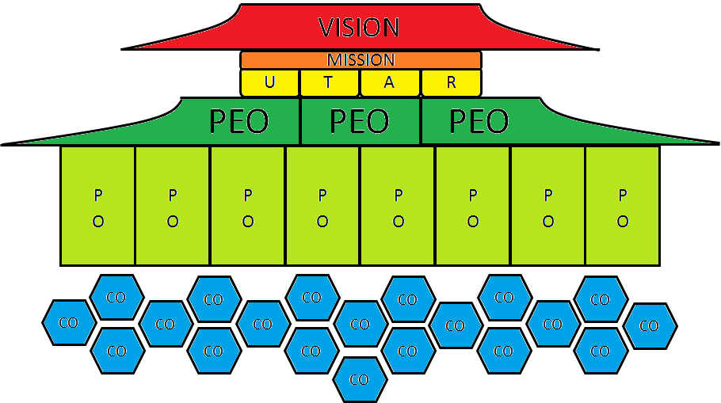
OBE Framework
Professional Level
Programme Level
Course Level

Slide 4
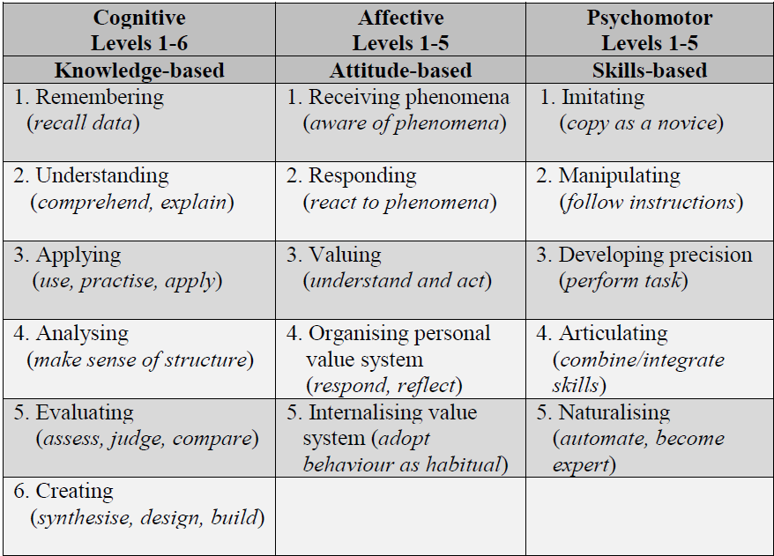
Course Outcomes

Slide 5
Programme Outcomes (PO)
Programme Outcomes refer to statements that describe what the students should have achieved by graduation time;
Address Cognitive (C), Psychomotor (P), and Affective (A).
MQA’s 8 Learning Outcome Domains:
Knowledge (C)
Practical Skills (P)
Social Skills & Responsibilities (A)
Values, Attitudes & Professionalism (A)
Communication, Leadership & Team Skills (P & A)
Problem-Solving & Scientific Skills (C)
Information Management & Lifelong Learning Skills (P & A)
Managerial & Entrepreneurial Skills (P & A)

Slide 6
Mapping of Course Outcome to Programme Outcome
Course Outcome
contributes to the achievement of
Programme Outcome

Slide 7
Programme Educational Objectives (PEO)
PEOs describe the expected achievements of graduates in their career and professional life a few years after graduation.
PEOs are assessed through Alumni Survey after 3 – 5 years of graduation.

Slide 8

UTAR Vision and Mission

Slide 9
UTAR Six Educational Pillars
Virtue and Morality
Knowledge and Intellect
Physical and Mental Health
Sociality and Humanitarianism
Aesthetics and Harmony
Creativity and Innovation
UTAR Soft Skills Development Certification
7 Core Components:
Communication & Language Skills
Critical Thinking, Creative Thinking
& Problem Solving Skills
EQ & Teamwork Skills
Moral & Professional Ethics
Leadership Skills
Lifelong Learning & Information
Management
Entrepreneurship Skills
8 MQF Learning Outcomes Domains (LODs):
Knowledge
Practical Skills
Social Skills & Responsibilities
Values, Attitudes & Professionalism
Communication, Leadership & Team Skills
Problem-Solving & Scientific Skills
Information Management & Lifelong Learning Skills
Managerial and Entrepreneurial Skills
Extra-Curricular Activities/
Professional and External Activities

Slide 10
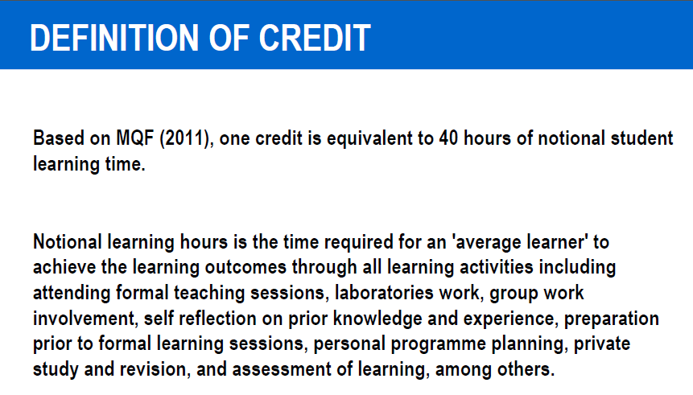
Student Learning Time

Slide 11
Student Learning Time

